Slide 1
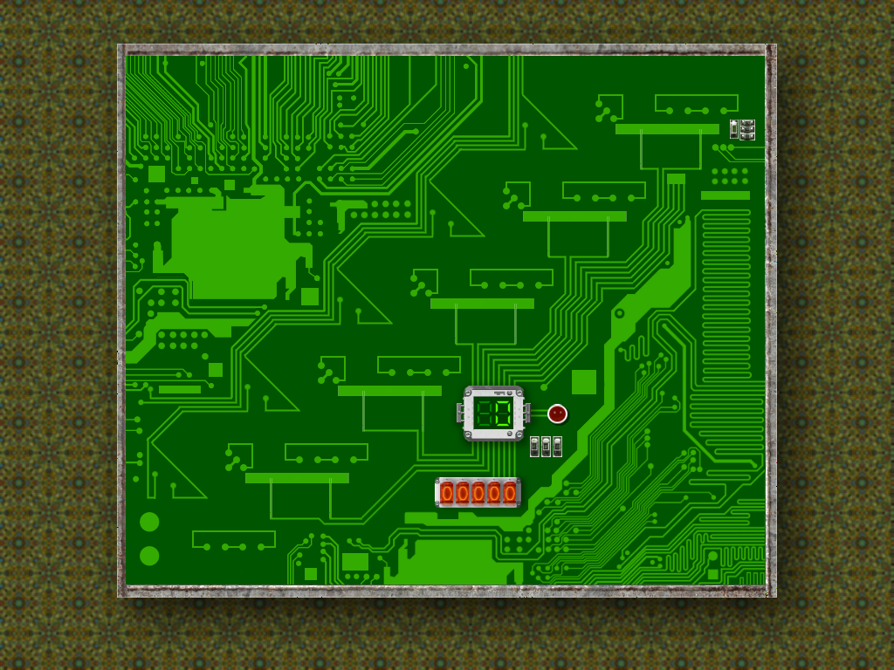
(a) Least significant bit
(c) Decimal counter
(b) Most significant bit
(e) Overflow
(d) Binary counter

Slide 2

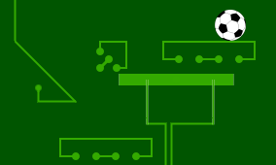

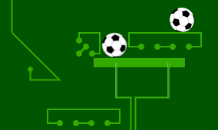
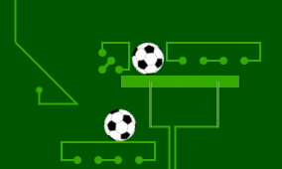
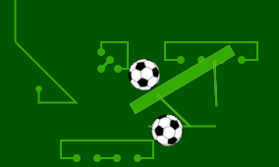

(a)
zero
(b)
(c)
one
(d)
(e)
(f)
(g)
zero carry one
(h)
zero

Slide 3

$$x_{4}$$
$$x_{3}$$
$$x_{2}$$
$$x_{1}$$
$$x_{0}$$
$$1$$
Bit Add
$$x$$
$$y$$
Bit Add
Bit Add
Bit Add
carry
$$z$$
$$x∧y$$
$$x⨁y$$
Bit Add
Bit Add
overflow
$$z_{4}$$
$$z_{3}$$
$$z_{2}$$
$$z_{1}$$
$$z_{0}$$

